Slide 1
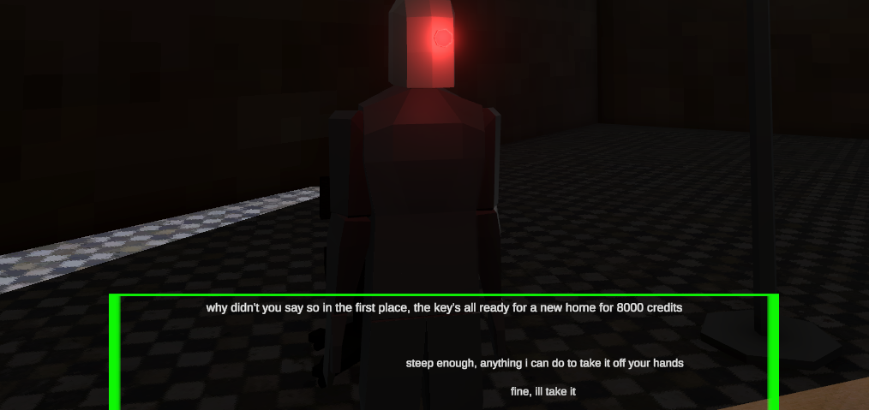
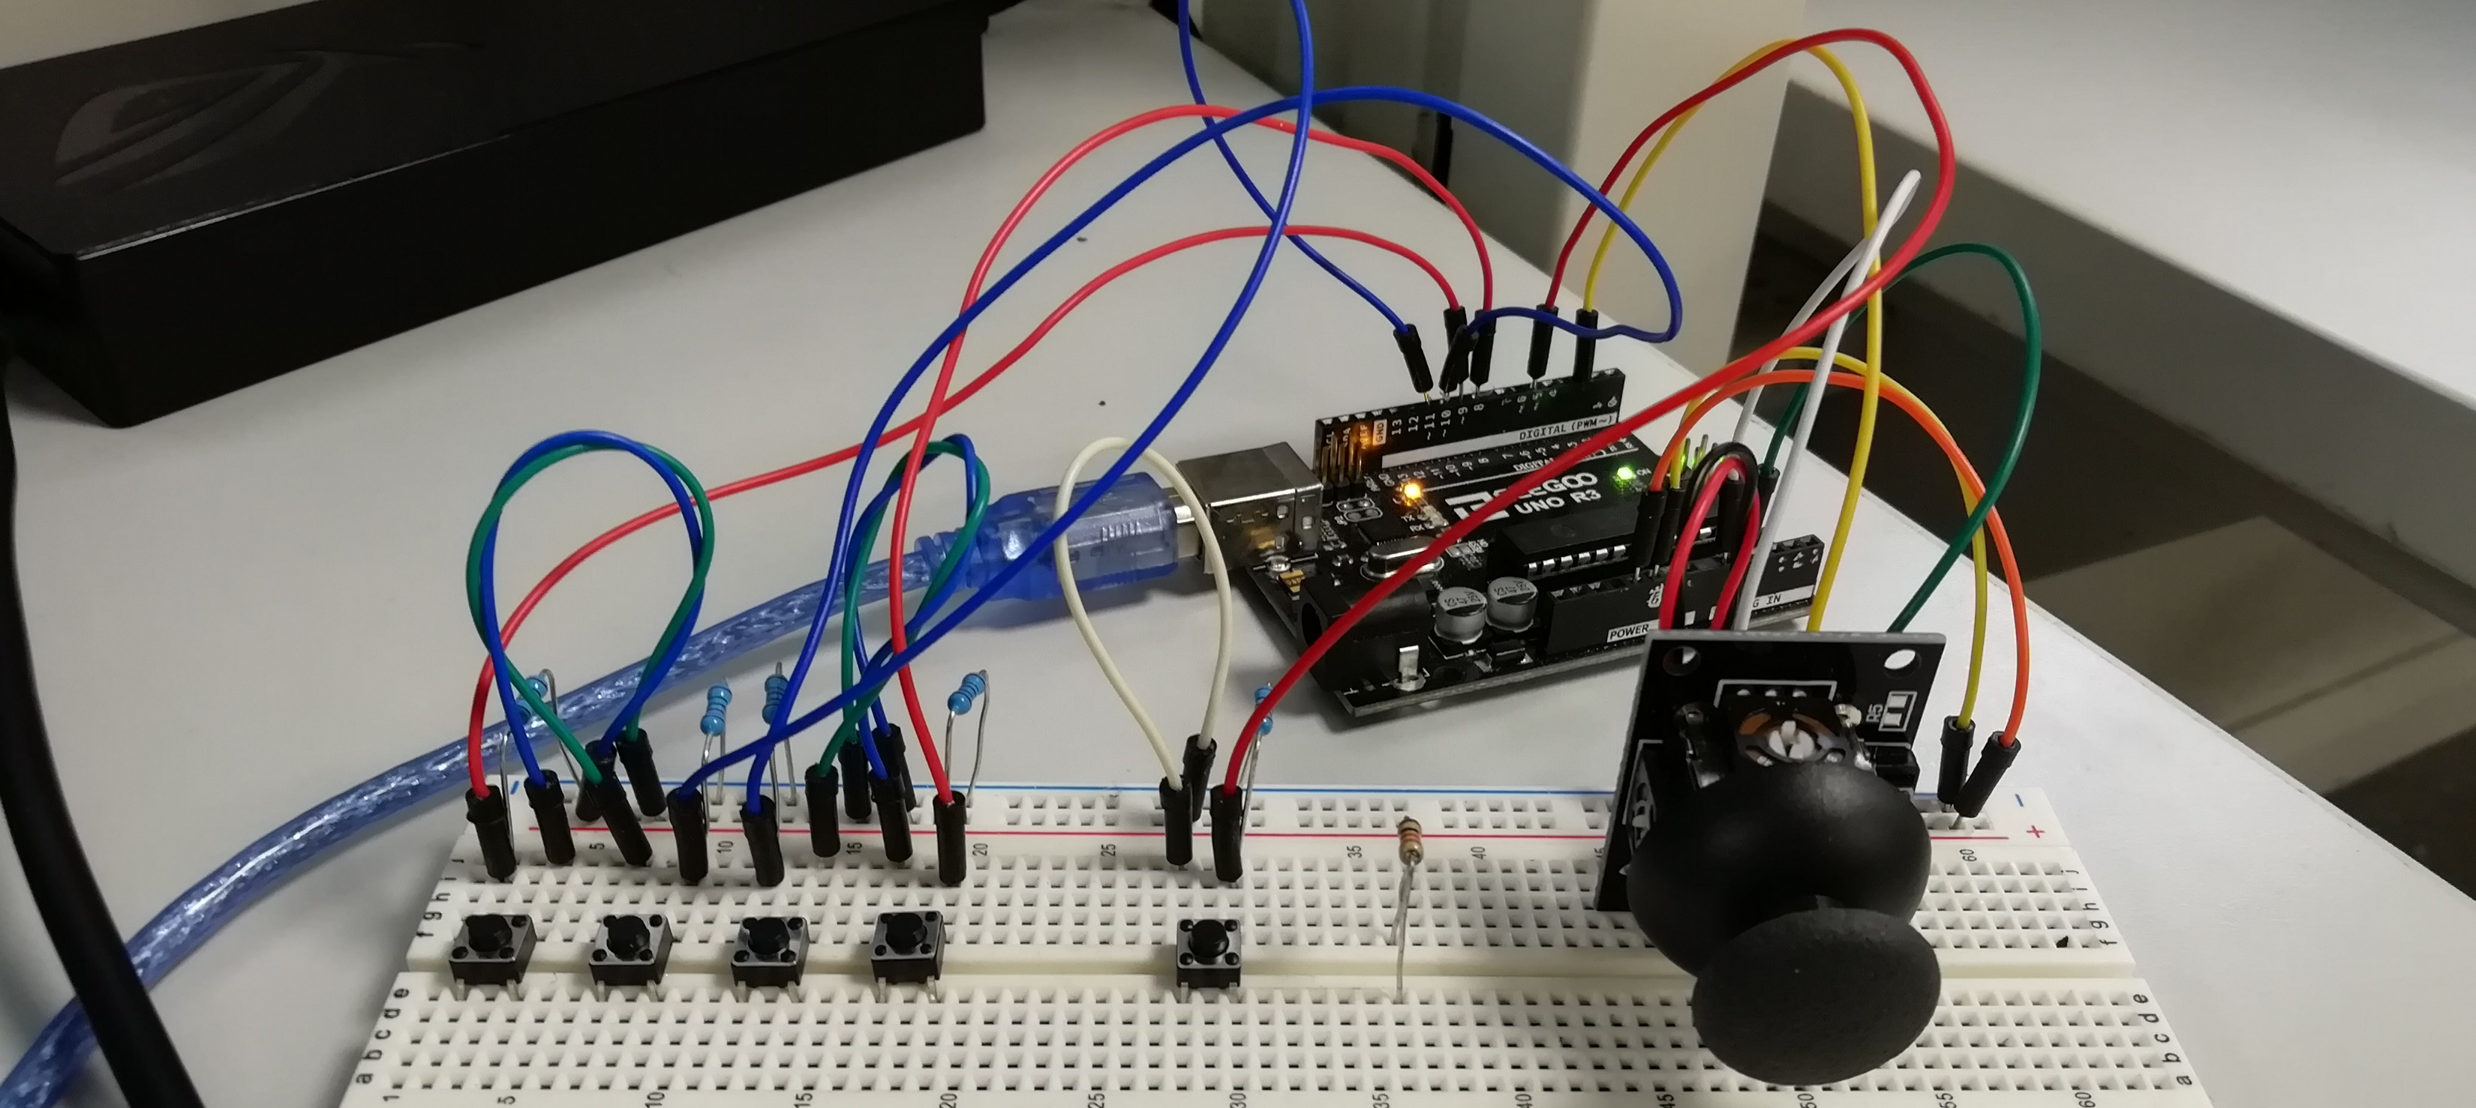
Project Deckard
Maghnus O Donnell – G00377514

Slide 2
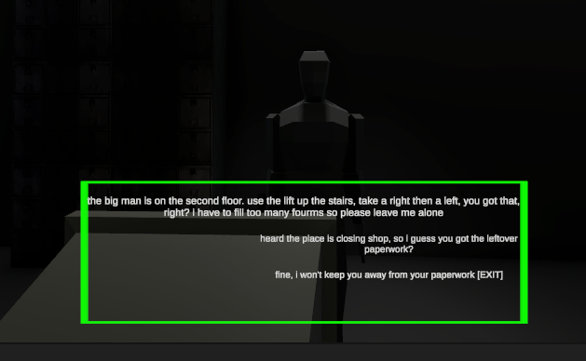
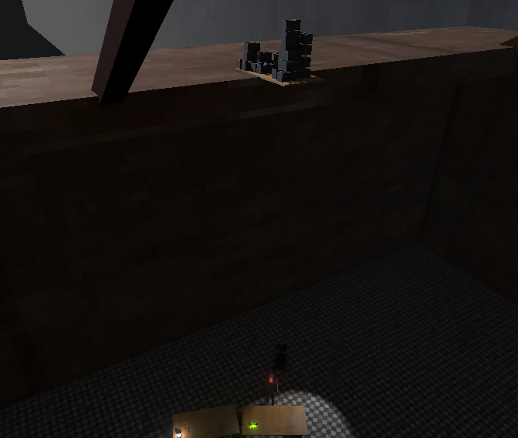
Project Deckard - About
Inspired by games like Half-Life 2 and Prey (2017), as well as films like Blade Runner and Ghost in the Shell.
Was created because the last Blade Runner game was create by Westwood studios in 1997.
Play as a bounty hunter to track down a suspect, whose “identity” is randomly picked when starting a new game.
Given multiple ways to solve in-game roadblocks.
Can talk to other Non-Playable Characters to find out where the suspect is.
Parts of the game can change depending on the suspect’s identity.

Slide 3
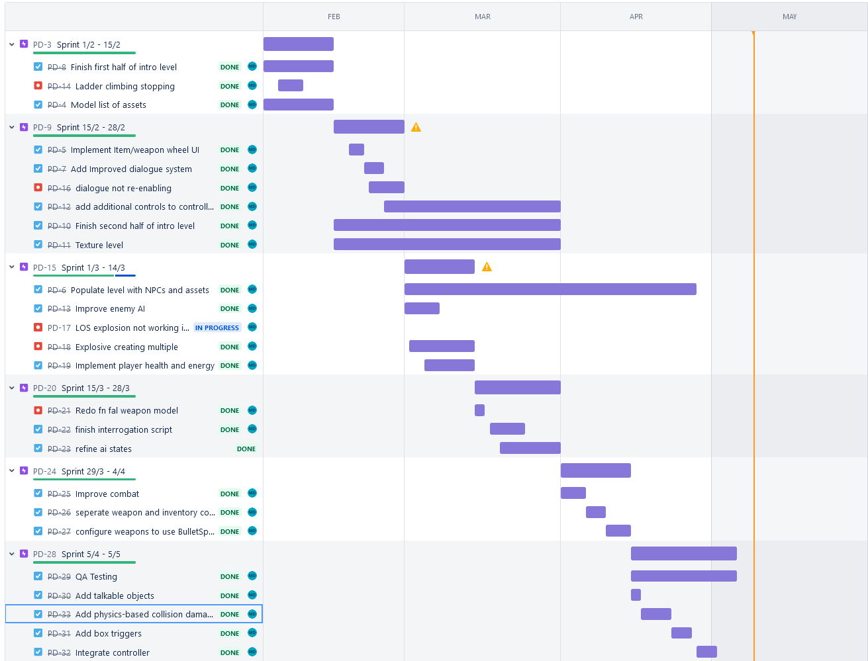
Project Deckard – Jira Project Management

Slide 4
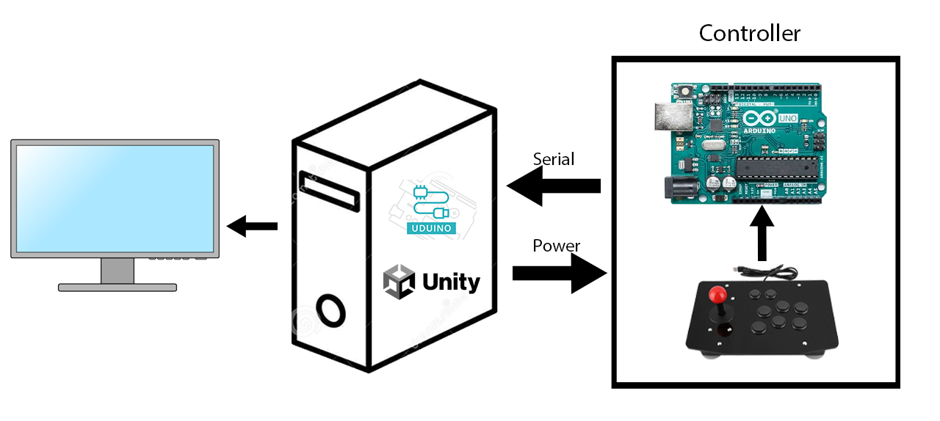
Project Deckard – Architecture Diagram and Tools
Tools and Technologies used:
Unity Editor
Uduino Unity plugin
C# programming language
Blender
Photoshop
Audacity

Slide 5
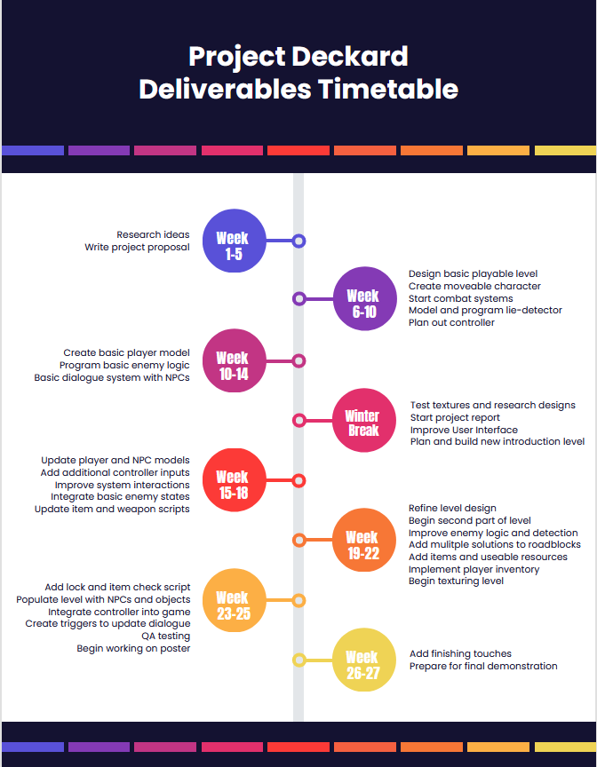
Project Deckard – Deliverables Timeline

Slide 6

Project Deckard - Controller
Interfaces to Unity using the Uduino plugin.
Allows player to move the character on the x and z axis, and to rotate the camera
Player can fight enemies they might encounter.
Consists of:
Arduino Uno
PS2 joystick module
Set of buttons

Slide 7
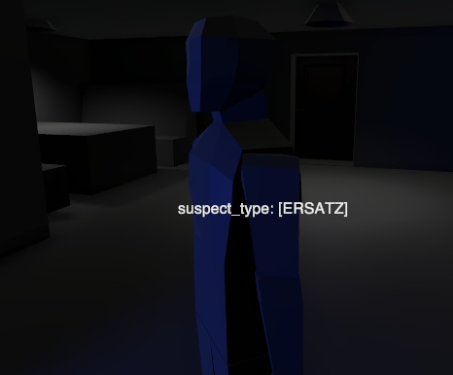
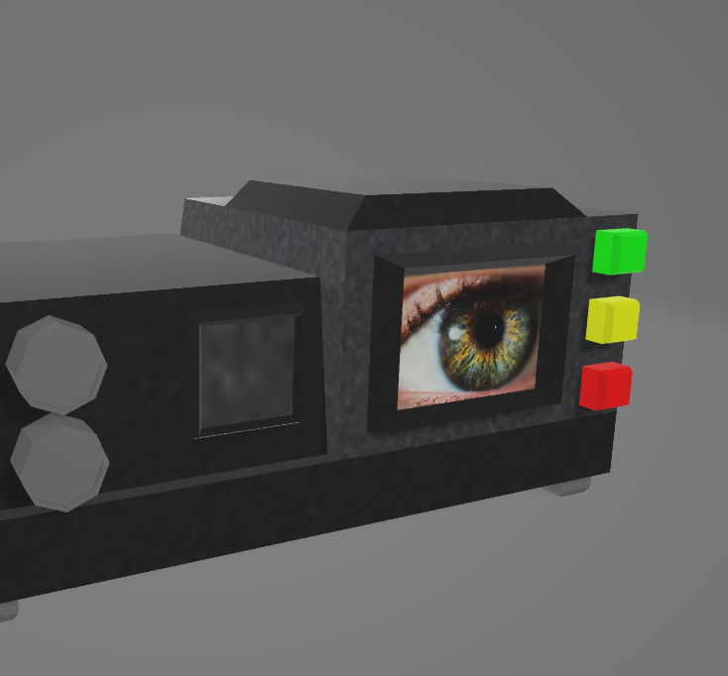
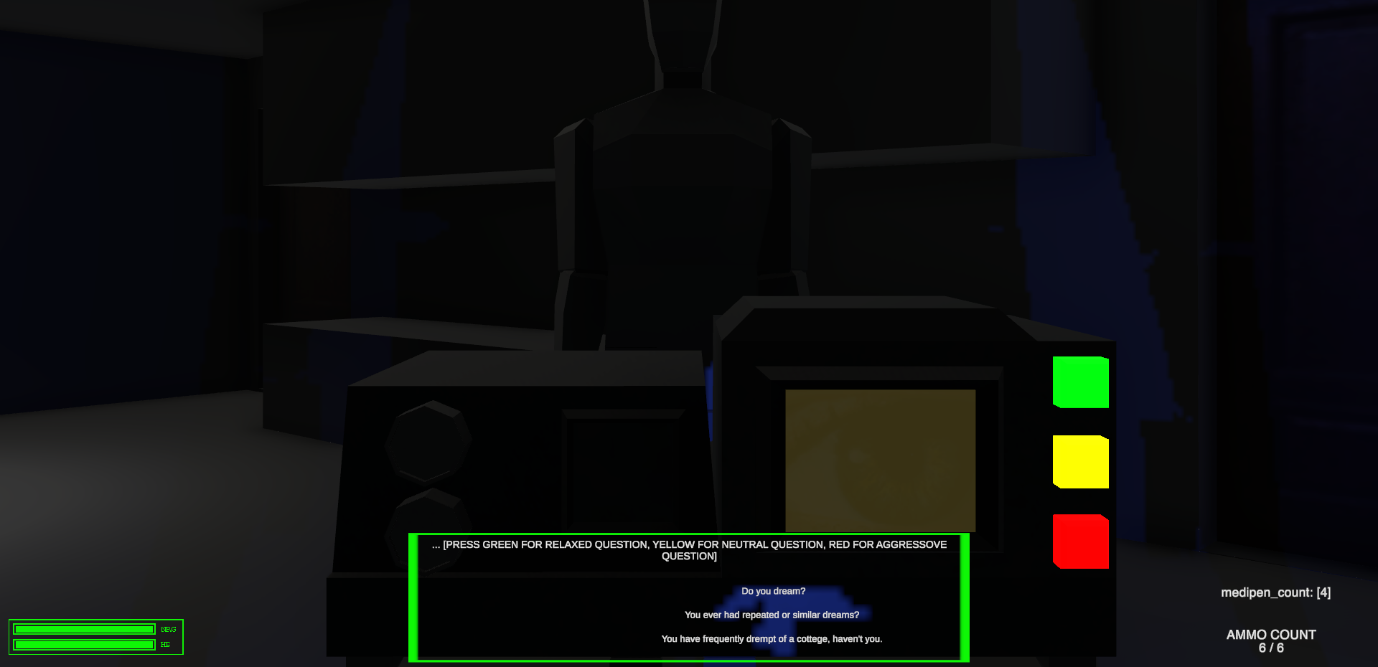
Project Deckard - Mini Game
Interacting with the suspect using the “F” key begins a conversation that can lead to the interrogation mini game starting.
Pressing buttons on machine progresses interrogation and increases the suspect’s “aggression”.
If suspect’s aggression is between aggression limits defined in the interrogation ScriptableObject, suspect’s “identity” is revealed.
Exceeding limit turns suspect aggressive and will attack player. Not reaching limit defines suspect as “unknown”, so player must search for clues.
Clues around level reveal suspect’s identity.

Slide 8
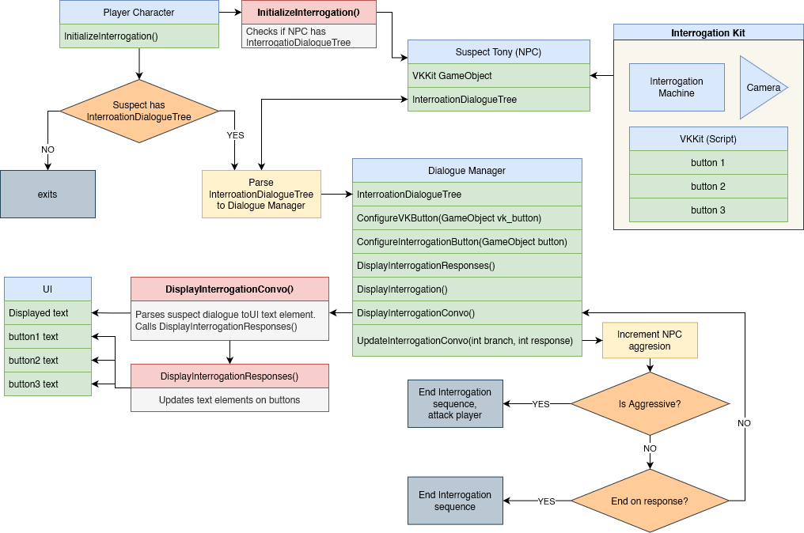
Project Deckard - Mini Game UML Diagram

Slide 9
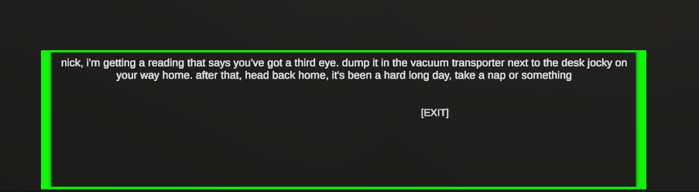
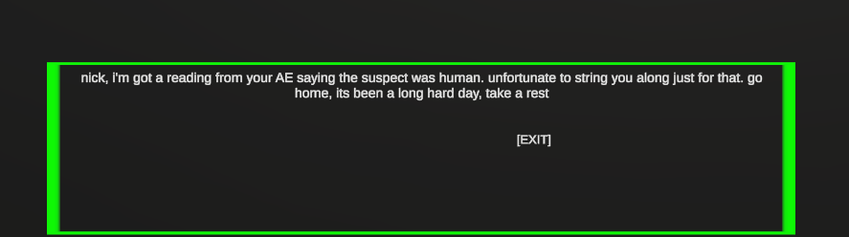
Project Deckard – Realtime Dialogue Update
Specific scripts read the suspect’s interrogation ScriptableObject to check their “identity”.
If the suspect is a fake human, the top text is displayed.
If the suspect is a real human, the bottom text is displayed.
Box triggers can update the dialogue of certain non-playable characters when a player enters them with or without a specific item within the player’s inventory.

Slide 10
Thank you You can ask any questions now

